Slide 1

Java Gui Project
Tamanna Akter
ID:221- 15-5298
Section : 61_M

Slide 2

Project Name: My Calculator

Slide 3
Contents:
Project objectives
Introduction
Equipment’s
Methods
Users
Limitations of the Project:
Future enhancement
Reference

Slide 4

Project Objective
To develop a simple calculator using Java which provides Simple arithmetic operation.
The operation performed are:
Addition.
Subtraction.
Multiplication.
Division.
Clearing the content of the screen.

Slide 5
Introduction
▸ A calculator is a small, portable, often inexpensive electronic device that is used to perform both basic and complex operation of arithmetic.
Calculator is a tool by which we can solve our both daily life and academic mathematical problem

Slide 6


Equipment's:
Install Java on my machine.
▸ Install Java Ide (e.g., NetBeans, Eclipse).

Slide 7
Methods(cont.)
First, I make a layout how I want my calculator to look like.
As soon as layout completes, I started coding and using Java swing I make the layout of the calculator.
Now continuing further, I had to make sure that all keys are correctly performing operation on he screen.

Slide 8
Methods(cont.)
Now I add some logic so that we can concatenate two or more number and add logic to perform basic arithmetic operation.
▸ To do so first I use switch case logic later I use Script Engine Manager() method.

Slide 9
Methods(cont.)
As soon as coding gets completed, I run & debug mine code and wow great calculator start working.
Now I decided to make further description of mine project so that it can help others to.

Slide 10
Users:
Professional Office Worker
Desktop user
Students

Slide 11
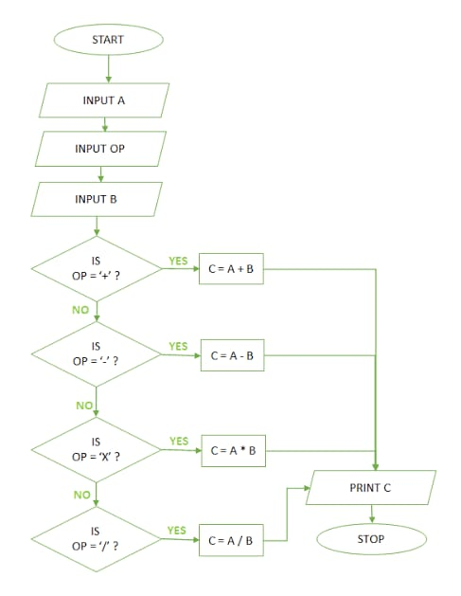
Flow chart

Slide 12
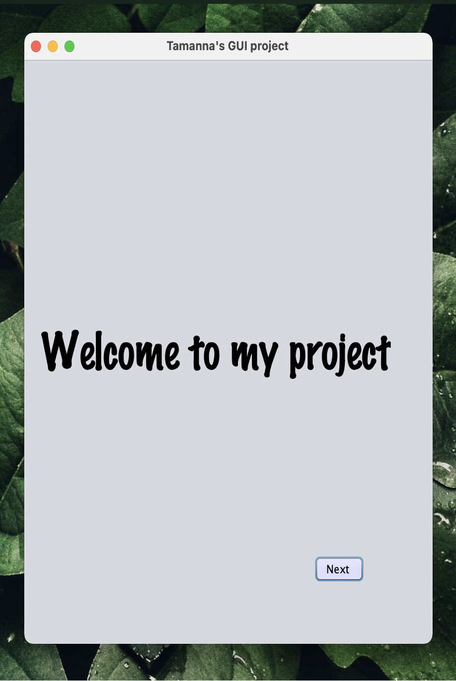
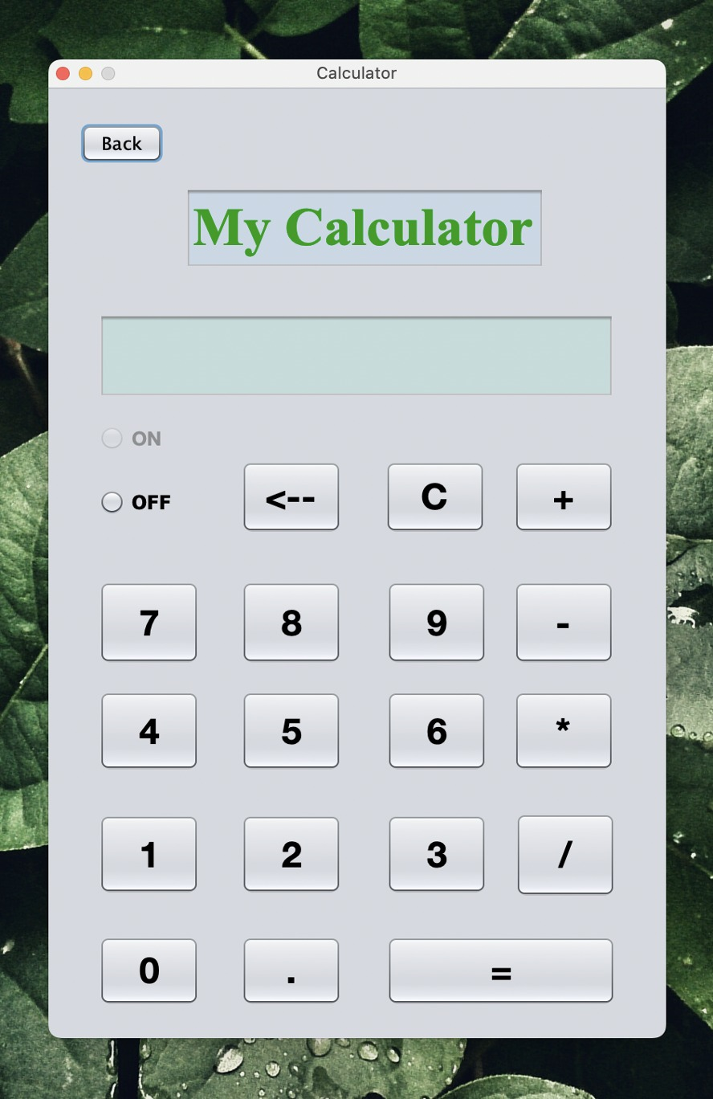
Screen Shot

Slide 13
Future enhancement
Implement this calculator on desktop.
App will be modified with Commerce Formulae, so that it can reach out more people .
It will be available on Google Play Store and app store, for the students after complete development.
People will be able to make graphs using this programmed.
It will always be free to use.

Slide 14
Limitations of the Project:
The four developers of the application were unable to resolve the following limitations/bugs-
It Does not calculate complex roots of nth degree polynomial.
Presently it can only be used by Engineering students only.

Slide 15

Reference
https://www.google.co.in
https://www.oracle.com/
https://eclipse.org/
https://www.javatpoint.com/java-swing

Slide 16
THANK YOU.

